Slide 1
BRITISH AIRWAYS
Predicting Customer Buying Behaviour
Build a predictive model to understand factors that influence buying behaviour.

Slide 2
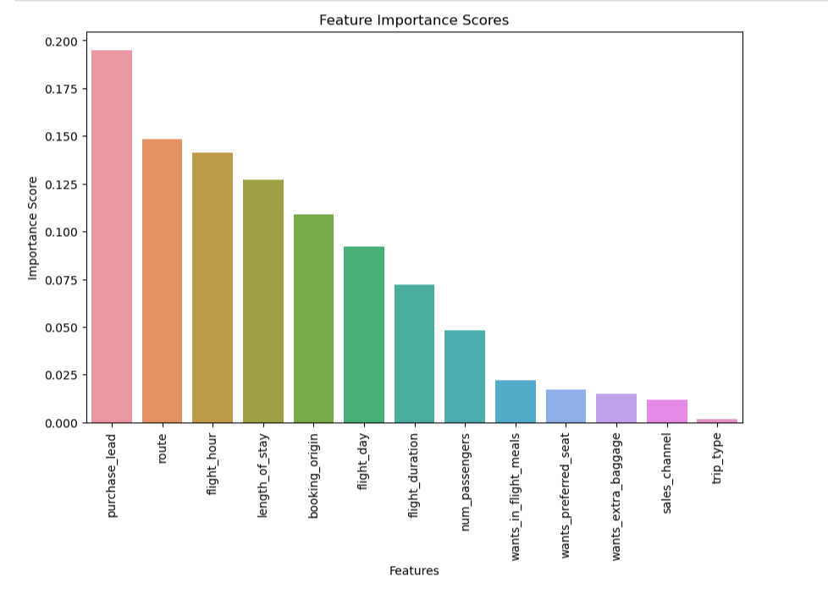
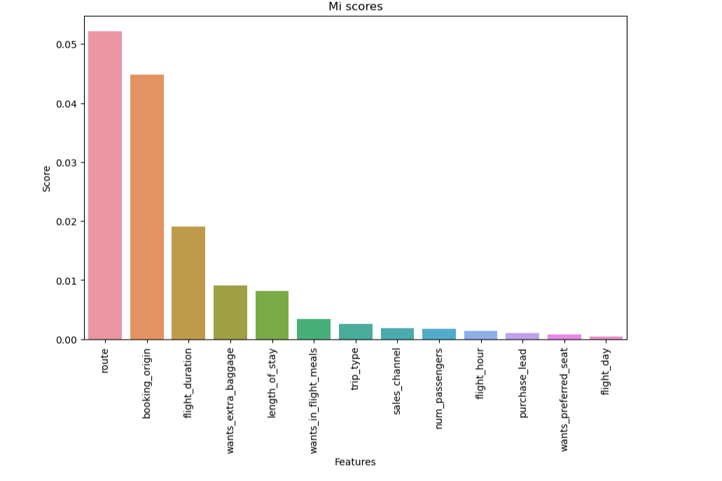
Attributes used for prediction route','booking_origin','flight_duration','wants_extra_baggage', 'length_of_stay','num_passengers','purchase_lead','flight_hour'

Slide 3
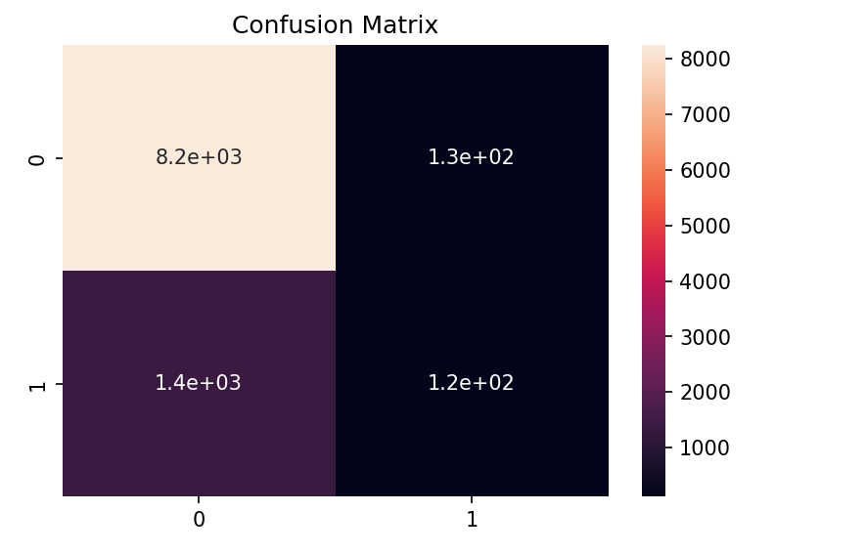
Deployed many algorithm and highest score was given by Random forest
ACCURACY: 84.8229684488181
AUC score: 0.5310323230596

Slide 4
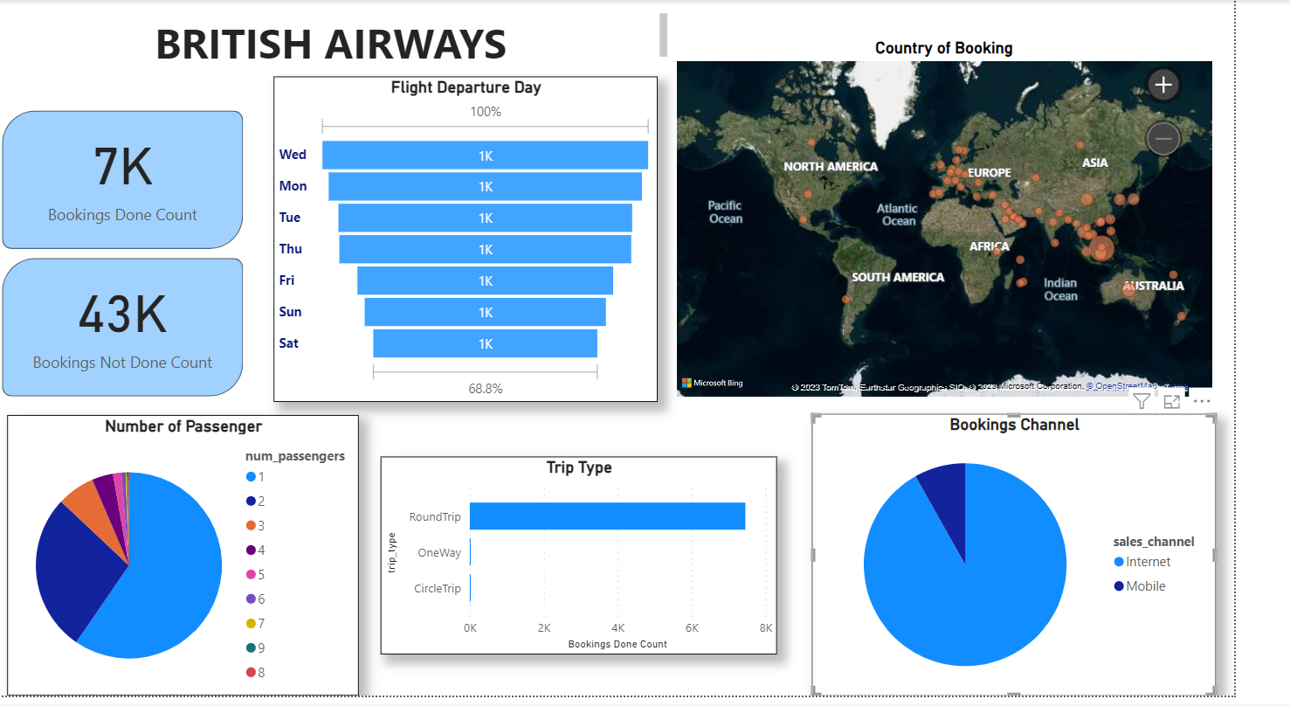
Power BI DashBoard

